Slide 1
Unexpected links between gut microbiome and cancer progression and therapy.
Pathway Tools Workshop.
February 12, 2018
Nathalie Scholler, MD, PhD
Director, Cancer Immunology. nathalie.scholler@sri.com

Slide 2

“Cancer is a global health crisis, with 12.9 million new cases diagnosed in 2009 worldwide and […] by 2030 this number could rise to 27 million including 17 million deaths unless we take more pressing action.”
Former NCI’s director John E. Niederhuber
The “War on Cancer”
National Cancer Act of 1971

Slide 3
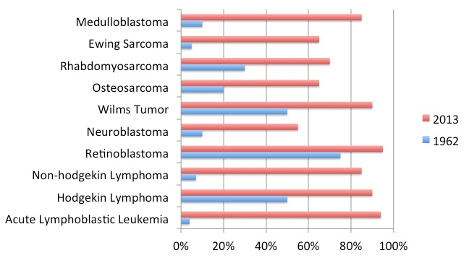
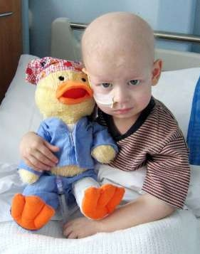
War on Cancer, Phase I: The Cult of the Offensive
Dominant strategic military theory before WWI
Attackers will be victorious regardless of circumstance
=> Bomb the enemy into submission.

Slide 4
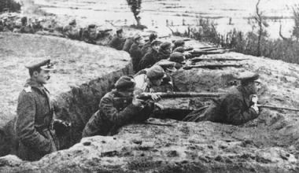
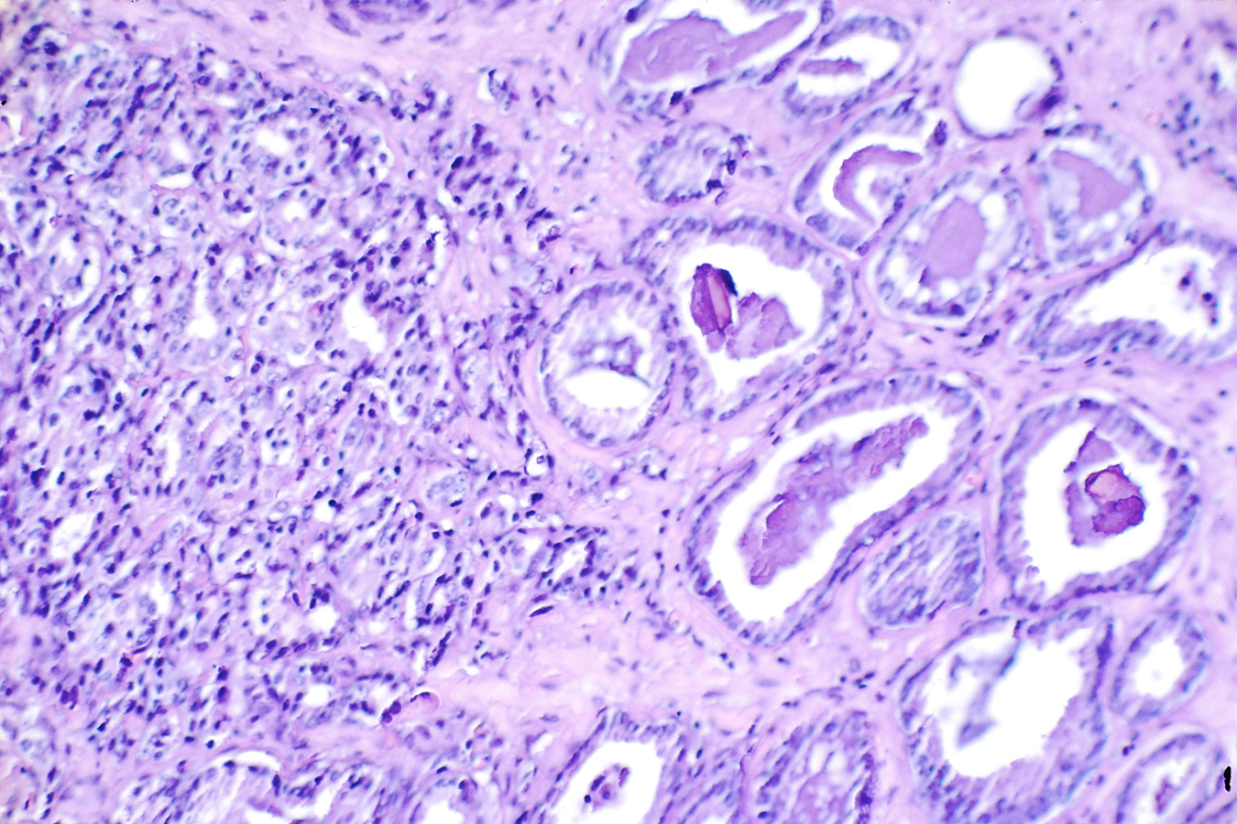
War on Cancer, Phase I: The Cult of the Offensive
Dominant strategic military theory before WWI
Attackers will be victorious regardless of circumstance
=> Bomb the enemy into submission.
Trench warfare
Immune cells
Tumor cells
Escalation
Heavy losses
Defeat of the attackers

Slide 5
Lessons from WWI applied to War on Cancer
Bombing vanquishes opponents in open terrain only
=> blood cancers
Entrenched opponents defeat bombing
=> solid tumors
=> Evolution to “Modern Western Military Art”
Paralyze and incapacitate rather than destroy directly
USE THE TERRAIN = IMMUNE SYSTEM
5

Slide 6
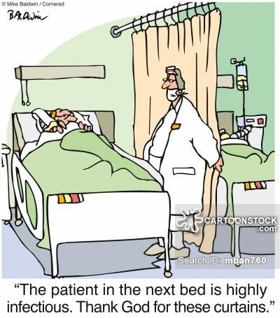
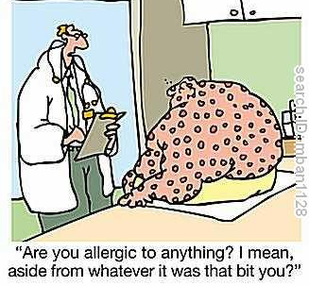

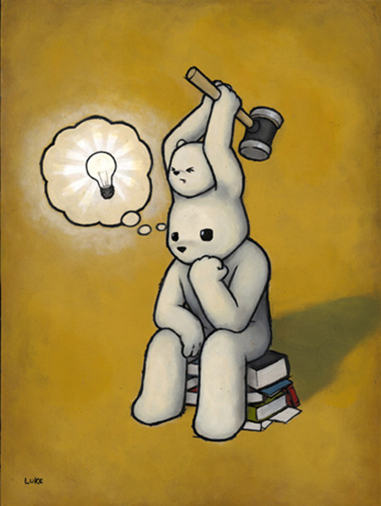

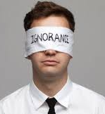
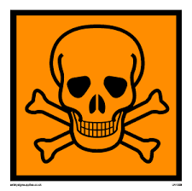
What does the immune system do?
Protects against germs
Allergies
Protects or Punishes
Infections
Allergies
Auto-immune diseases
Cancers
Inhibition
Misdirected reactions… but against what?

Slide 7

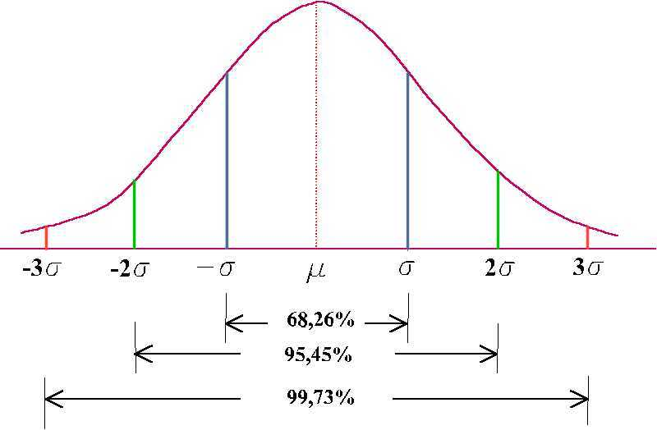
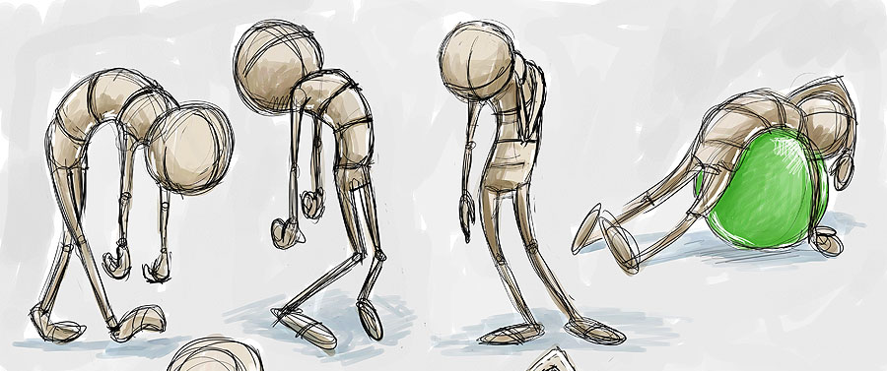

War on Cancer, Phase II: Tumor Immunology
Activation (effectors only)
Tolerance/Anergy
Exhaustion

Slide 8
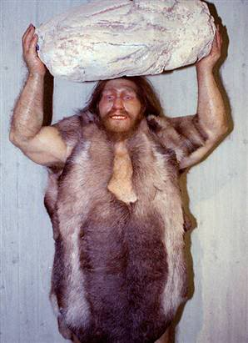

Innate immunity
Adaptive immunity
Immediate activation
Maturation via Pattern Recognition Receptors and chemokines
Conserved in the evolution
No or little education required
Delayed activation
Maturation depends on developmentally programmed mutational changes.
Recent development of evolution
“Education” and “memory”
Immunotherapy

Slide 9
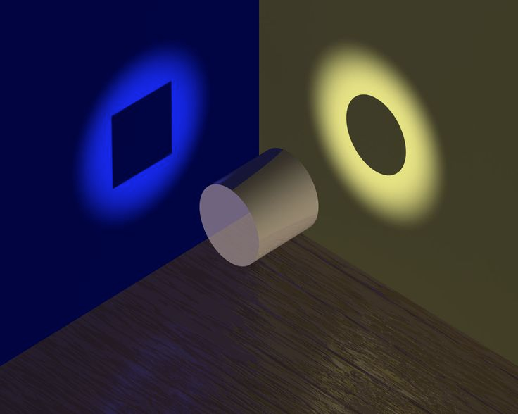
There is no truth. There is only perception.
- Gustave Flaubert

Slide 10

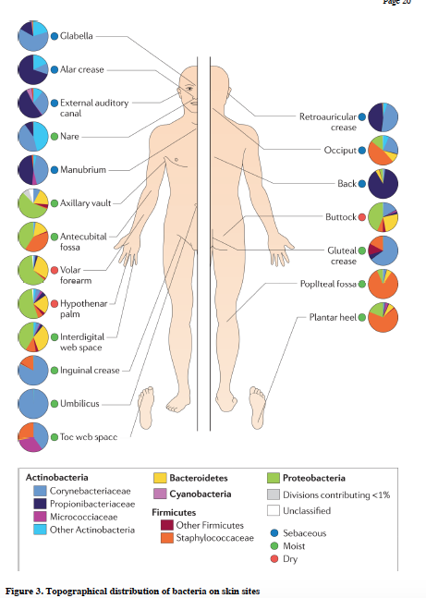
Emerging concept: Human as a supra-organism
Interactions between the microbiome and cancer are clinically demonstrated
Four dominant bacterial phyla with high diversity of species
Skin
Gut
Dry areas of skin

Slide 11
Relationship between bacteria and cancer
Therapeutic use
Intravesical bacille Calmette-Guérin (BCG/Mycobacterium tuberculosis) for bladder cancer
Streptococcus pyogenes + Serratia marcescens (“Coley’s toxin”) for inoperable sarcoma
Epidemiological evidences
Salmonella tiphy chronic carrier /gallbladder cancer
Streptoccocus bovis / colorectal tumors
H. pylori gastric adenocarcinoma /esophageal cancer
Chlamydia pneumoniae / lung cancer

Slide 12
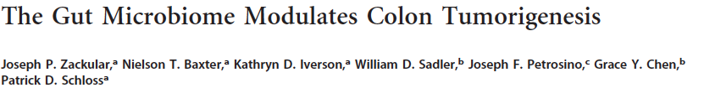
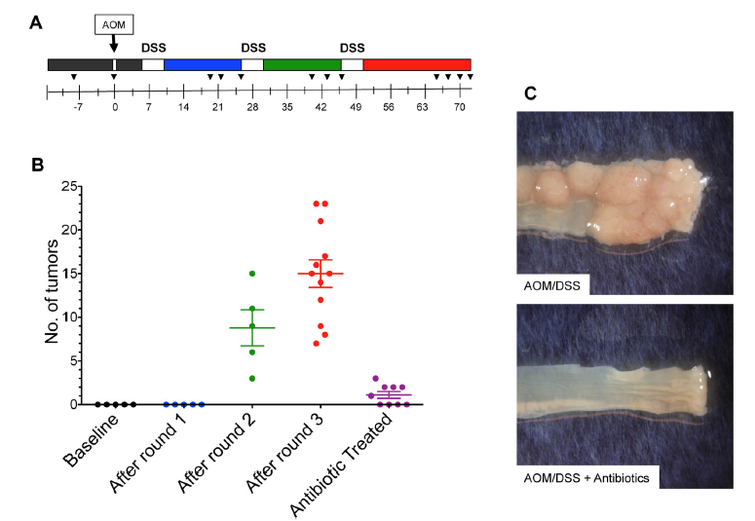
MBio. 2013 Nov 5;4(6):e00692-13. doi: 10.1128/mBio.00692-13.
Inflammation-induced tumorigenesis is commensal-dependent
AOM = Azoxymethane
DSS= dextran sodium sulfate
Notes:
Azoxymethane
Experimental CRCs develop in the colon of AOM/DSS-treated mice

Slide 13
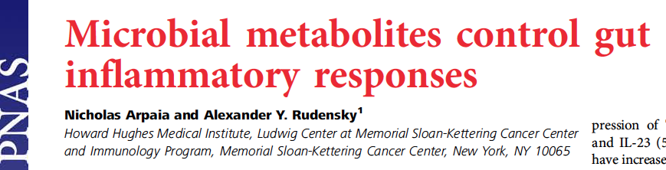
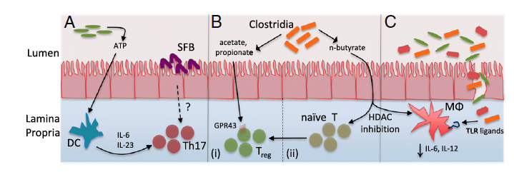
‘14
Short chain fatty acids influence magnitude and quality of the immune response
(Histone deacetylase)
Innate immunity
Innate immunity
Adaptive immunity

Slide 14
It is not the chemicals nor the microbiome that generate cancer,
it is the reaction to a combination of factors.
Microbial gene products,
Metabolites &
Immune modulators
BF Bacteroides fragilis;
ETBF, entero-toxigenic Bacteroides fragilis;
FadA, fusobacterium adhesion A;
HDAC, histone deacetylase;
IL, interleukin;
LPS, lipopolysaccharides.
Notes:
It’s not stress that kills us, it is our reaction to it.
Hans Selye

Slide 15
How to uncover the impact of the microbiome in the etiology and treatment of cancer?
Cancer Microbiome Congress in Boston on 8-9 May 2018
What strategies are necessary to create a functional understanding of the interactions between commensal bacteria & cancer?
Is the microbiome the missing key to immunotherapies?
How can we integrate the fields of microbiology and oncology to translate research into viable cancer therapeutics?
Do microbial therapeutics have the potential to be utilized as standalone therapies?
How can we exploit the microbiome to modulate the immune system to create a new form of personalized medicine?
Could "microbiome-on-a-chip" one day replace mouse models?

Slide 16
All
Gram^{+/-}
Gram⁻
Microbiota-dependent immunomodulatory effects of CTLA-4 Ab
Microbiota-dependent neutrophil accumulation in tumors

Slide 18
Future directions
Precision medicine promises medical treatments that are optimized to account for individual patients’ genetic makeup and differences in lifestyle and environment.
The presence or absence of speciﬁc bacterial community members, or even their metabolites, can alter the prevalence, severity, and treatment of cancer and may serve as prognostic biomarkers.
Increasing the access to centralized, cloud-based repositories for whole genome and transcriptome sequencing databases will facilitate data mining approaches by computational scientists.
Combining pharmacogenomics information with custom microbial organisms or their speciﬁc metabolites will allow for precise dosing, symptom management, and improved therapeutic responses

